Slide 1

Dota2
Database
Chengwei Ye
Frank Egan
Ruonan Feng
Xinting Yao

Slide 2
Index
Introduction
Approach
Data Collection
Database design
Functions
Back end development
Web app demo
Conclusion & expectation

Slide 3
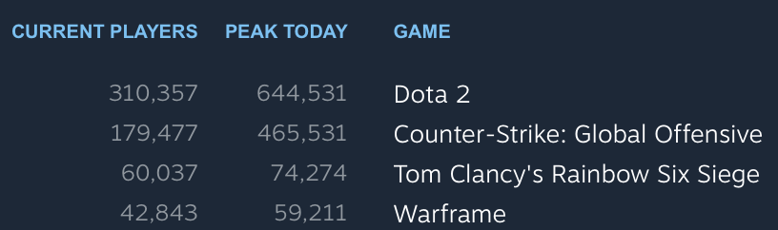
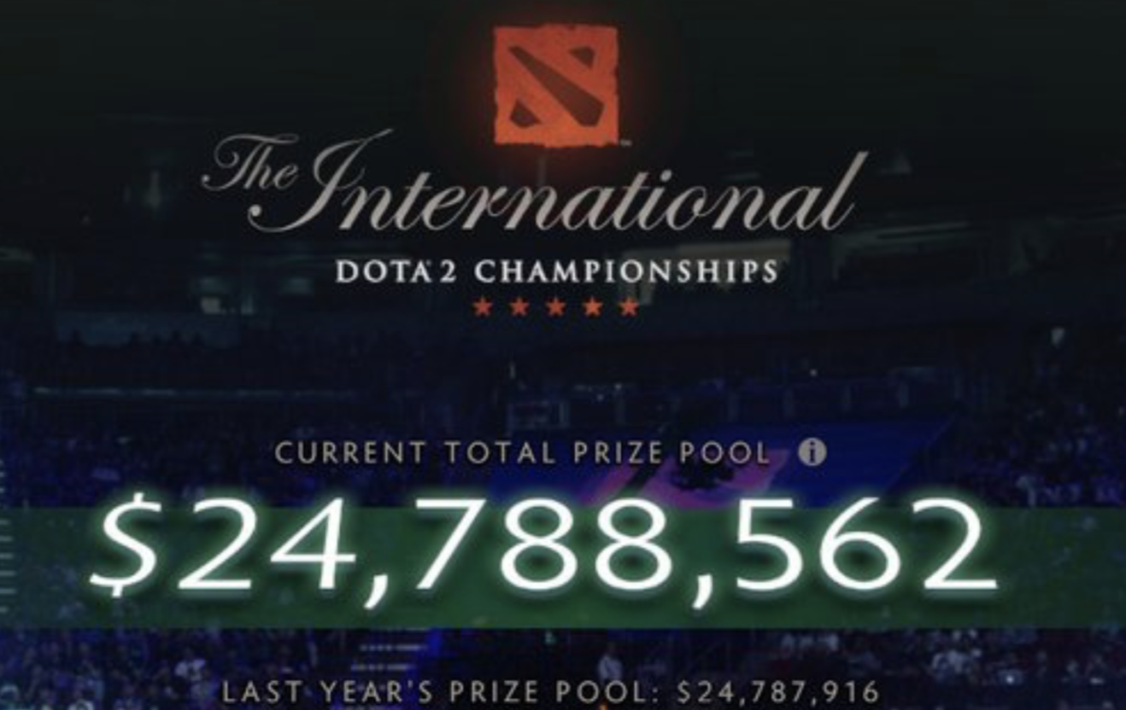
Introduction
3 facts
DOTA2, most popular game on Steam
Online video game,
millions of millions of millions of data are generated automatically
Largest prize pool

Slide 4
Approaches
Data Access:
OpenDota API
Platform:
Heroku
Structured Query Language:
PostgreSQL
Back end:
Node.js
Notes:
Load data, develop web application on heroku

Slide 5
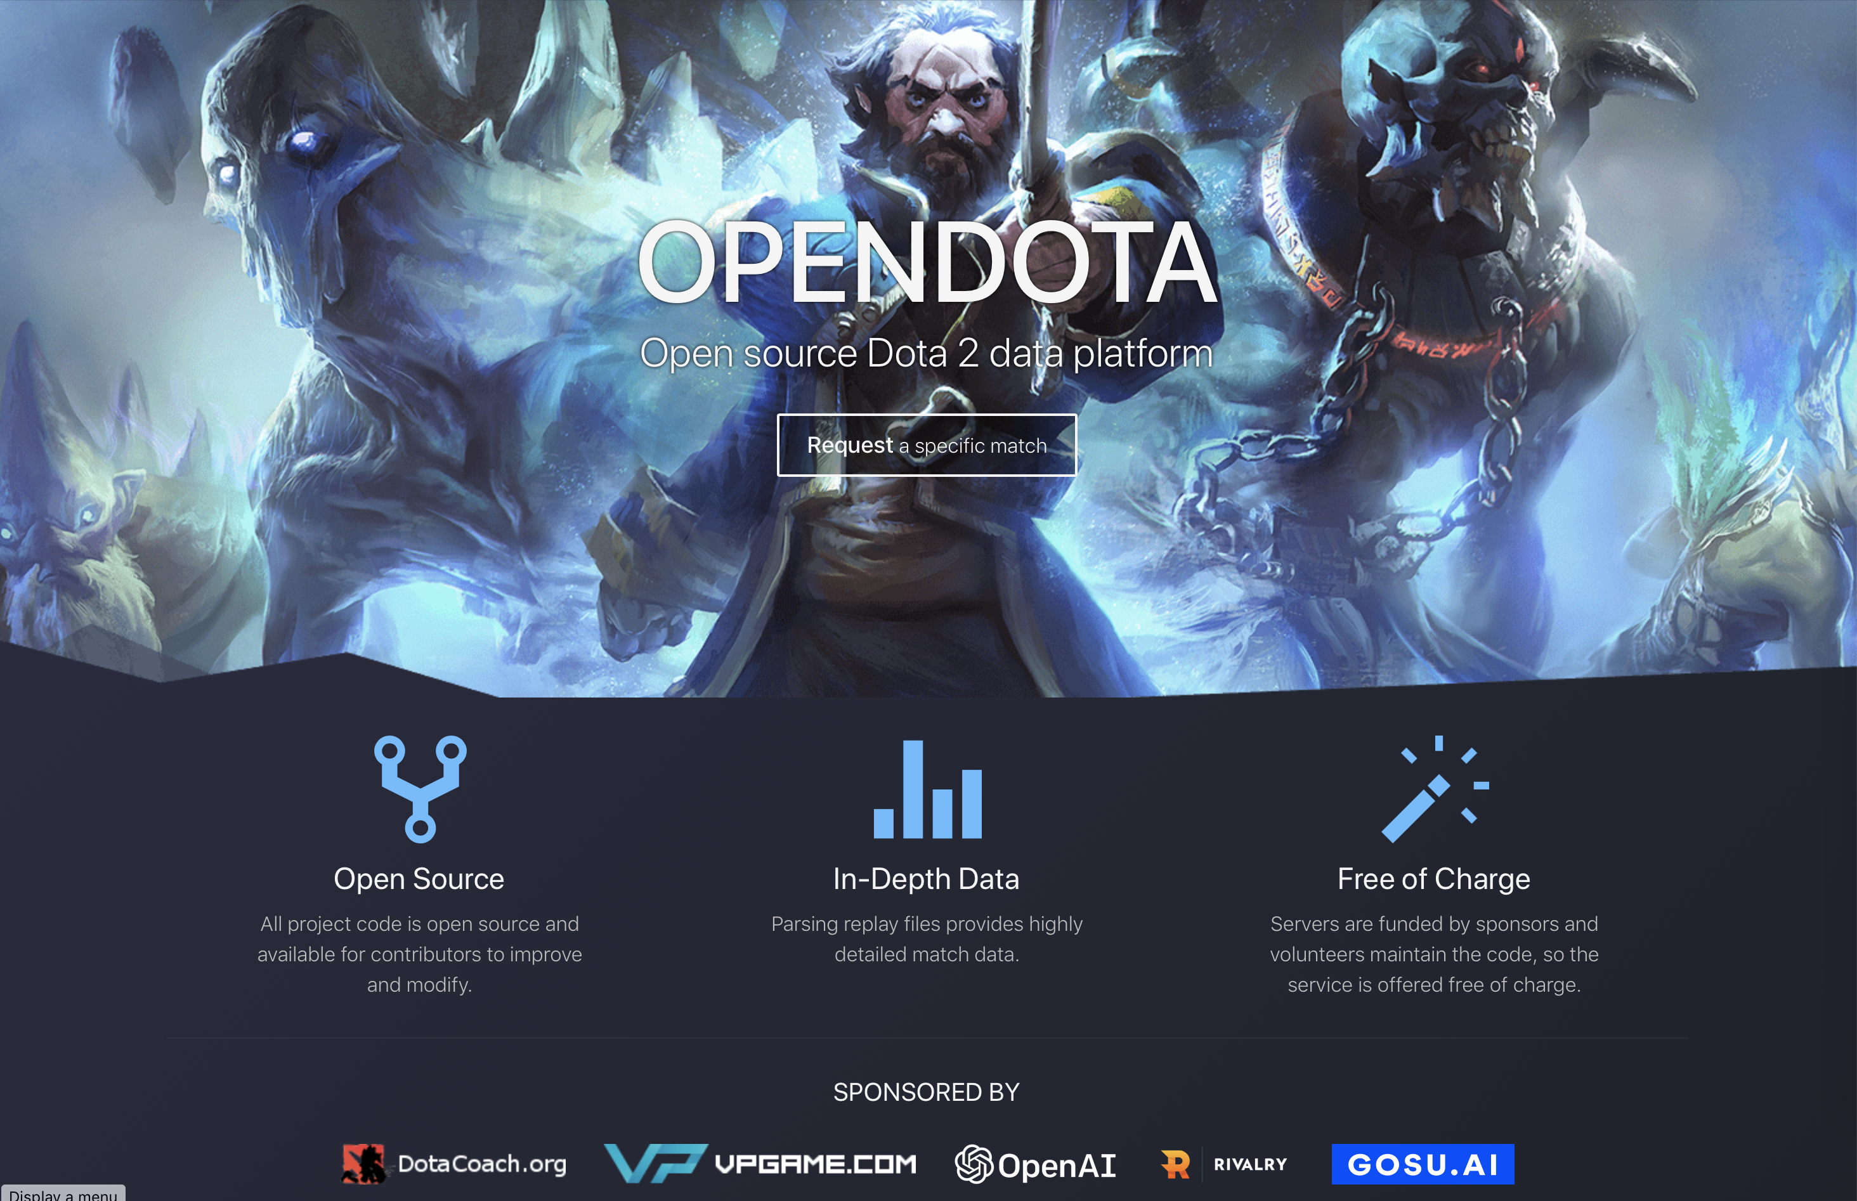
Data Collection
Source: opendota.com
We collected
1140 users
307 matches
116 heroes
272 items
Notes:
Load data, develop web application on heroku

Slide 6
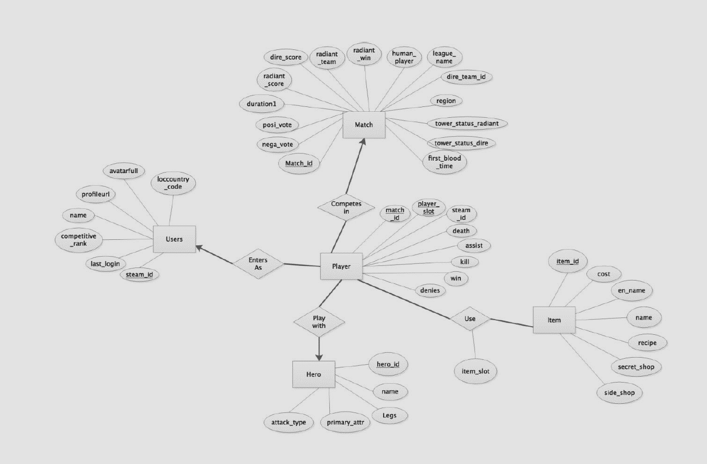
Design
5 entities
Tens of attributes
Match
Users
Player
Item
Hero
roles

Slide 7
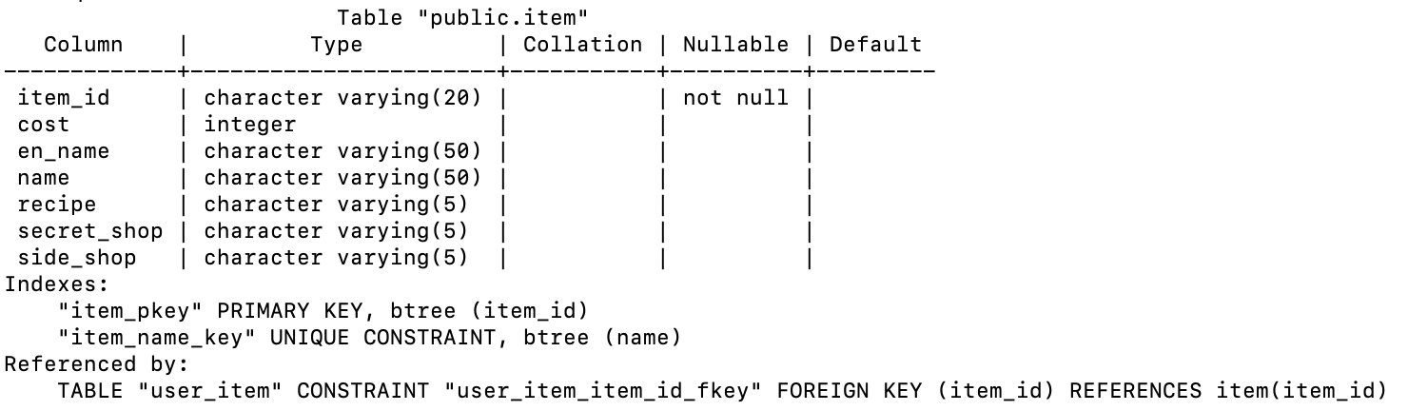
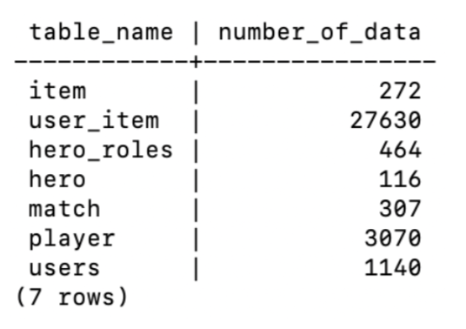
Create table
Map ERD into Relations
Anonymous players
Boolean Value: radiant_win
Add multivalued attribute “role” to hero entity

Slide 8
Anonymous players
Users
Steam_id | rank | name
149838098 | 37 | happy
139487028 | 200 | rock
Steam_id | rank | name
149838098 | 37 | happy
139487028 | 200 | rock
000000000
Players
User_Item
Match_id | Steam_id | Player_slot
4196318122 | 149838098 | 1
4196318122 | 139487028 | 2
4196318122 | 000000000 | 3
4196318122 | 000000000 | 4
Match_id | Steam_id | Player_slot
4196318122 | 149838098 | 1
4196318122 | 139487028 | 2
4196318122 | 000000000 | 3
4196318122 | 000000000 | 4
Match_id | Steam_id | Player_slot
4196318122 | 149838098 | 1
4196318122 | 139487028 | 2
4196318122 |  | 3
4196318122 |  | 4
Match_id | Steam_id | Player_slot | Item_slot | Item_id
4196318122 | 149838098 | 1 | 1 | 39
4196318122 | 139487028 | 2 | 1 | 39
4196318122 | 000000000 | 3 | 1 | 56
4196318122 | 000000000 | 4 | 1 | 101

Slide 9
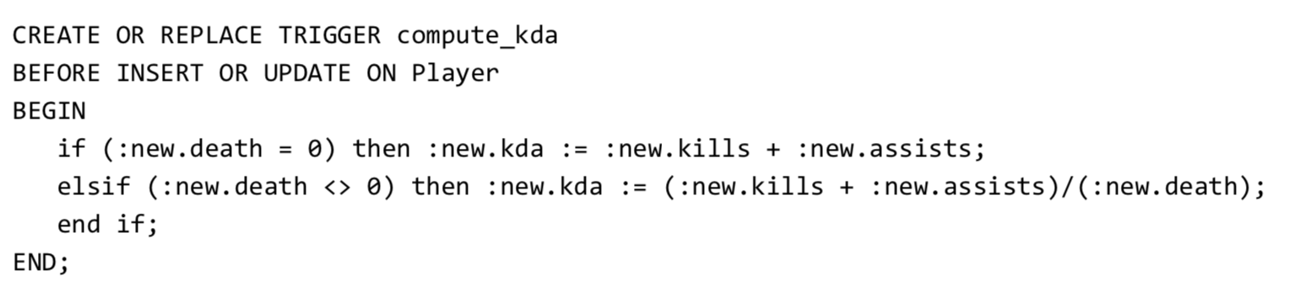
Trigger
Trigger 1 : prevent more than one user from choosing the same hero during a match.
Trigger 2 : In table 'Player', kda is a derived attribute, so we write a trigger to compute kda.

Slide 10
Function & View
Match
User
Hero
Item

Slide 11
Function & View
Match
Winner
All players' kill, death, assist, damage_to_hero, damage_to_tower, win/lost
Information of a match : duration, positive_votes, negative_votes

Slide 12
Function & View
User
Win rate
Favorite hero and the corresponding win rate
Favorite item
All matches
All teammates
Performance: kill, death, assist, deny, first_blood_time

Slide 13
Function & View
Hero
Fundamental information
Average performance of a specific hero
Pick rate and win rate
Item
Fundamental information
Using frequency

Slide 14
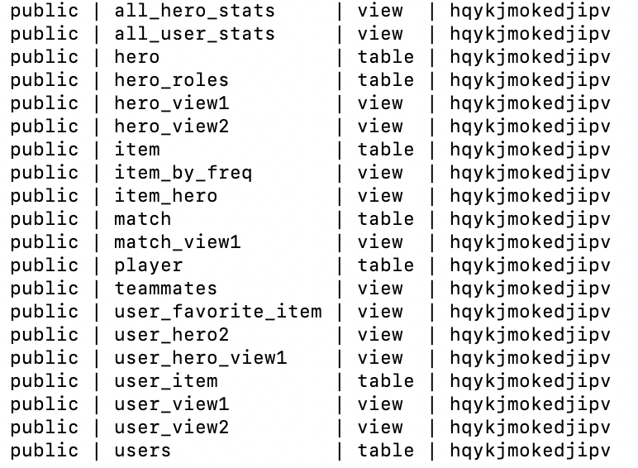
Function & View
7 Tables
13 Views

Slide 15




Function & View
# Find users' favorite item :
Steam_id
Match_id
Player_slot
Left join
Item_id
Match_id
Player_slot
Item_id
Left join
Item_id
En_name

Slide 16
Back end
Hosted on Heroku BaaS
DBMS: PostgreSQL
Server Side Code: Node.js
Client: Server side rendered HTML, CSS, and JS
HTTP requests are made by the browser to the backend. Our server parses these requests, makes the query, then populates the HTML with the responses and responds with an HTML file.

Slide 17
Demo
We created a live demo online.

Slide 18
Conclusion & Expectation
Add an interface to automatically retrieve data of certain user
More pictures, effects and fancy webpage
DotaMax

Slide 19
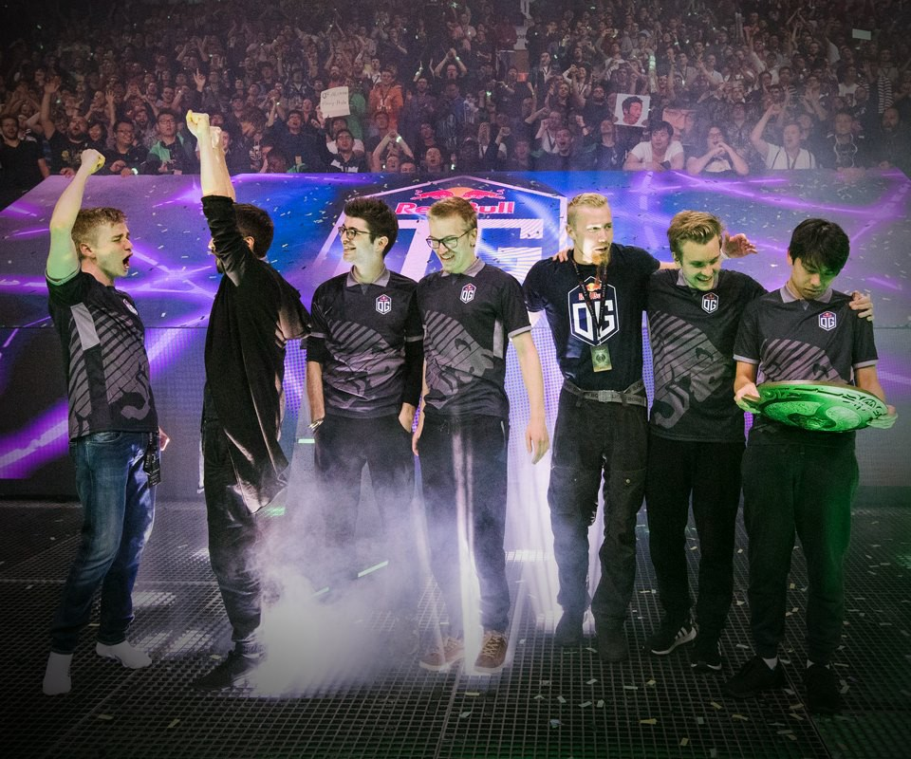
Thanks

